Slide 1


Accessibility: The Road to Success
February 19 – 21

Slide 2

Conference Schedule
February 19 12:00 PM | KEYNOTE: Accessibility: A Civil Right | Vance Martin , University of Illinois Springfield
February 19 2:00 PM | Mapping Your Success: Universal Design for Learning | Zach Petrea, Heartland Community College
February 20 10:00 AM | Simple Solutions: Accessibility for Audio and Video Resources | Robin Fisch, Sauk Valley Community College Lori Wendt, Parkland College
February 20 2:00 PM | Moving Down the Road to Success: How to Approach Accessibility | Kona Jones, Richland Community College Scott Rial, College of Lake County Susan Nugent, Lake Land College
February 21 10:00 AM | Moving Down the Road to Success: How Different Learning Management Systems Address Accessibility | Kona Jones, Richland Community College Selom Assignon, Harold Washington College Lara Tompkins, College of DuPage
February 21 2:00 PM | Digital Access and YOU | Becky Benkert & Mike Maxse, College of DuPage

Slide 3
Conference Archives
Recordings of these presentations will be available at:
http://www.ilcco.net/
under Resources & Events
For more information about ILCCO:
jeff.newell@illinois.gov

Slide 4

Presenters
Kona Jones
Director Online Learning
Richland Community College
Susan Nugent
Online Support and Instructional Technology Specialist
Lake Land College
Scott Rial
Director of Educational Technology
College of Lake County

Slide 5

Lake Land College’s Road to Accessibility
Added accessibility statement to website footer
Got buy in from administrative staff and faculty
Developed hands on training sessions to help faculty make documents more accessible
Purchased additional software to help make this process easier for instructors
https://www.lakelandcollege.edu/

Slide 6
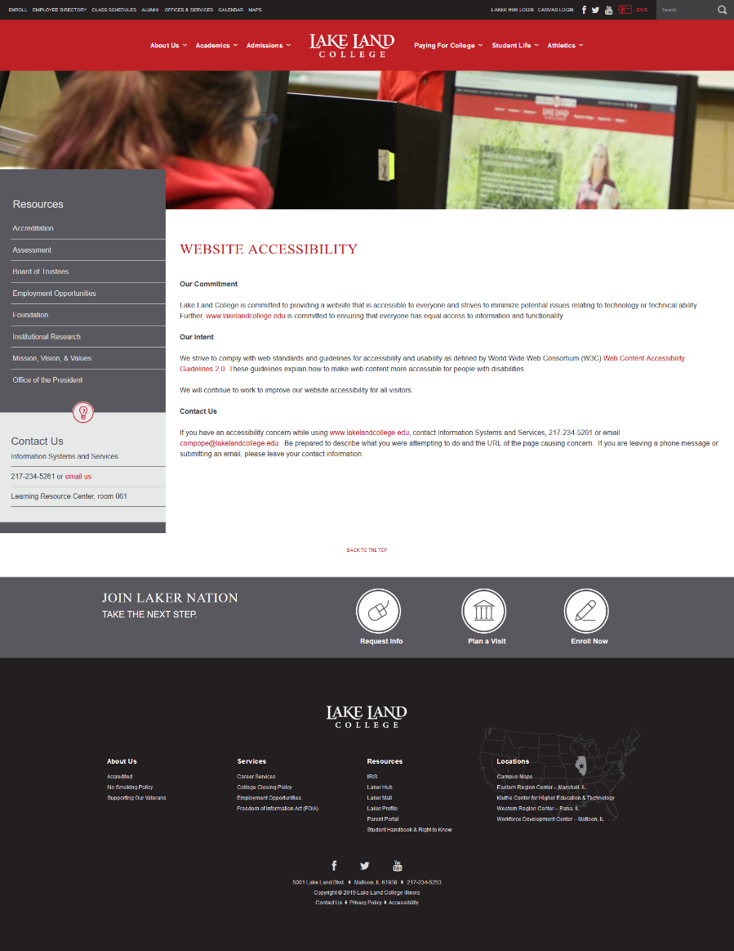
Added an Accessibility Statement to Website
Keep the statement simple
Provide a link to the WCAG 2.0 guidelines
Provide a way to report issues.
https://www.lakelandcollege.edu/

Slide 7
Canvas Accessibility Training
Mix of f2f, online training, and on demand resources
Incorporated accessibility training into Online Course Quality taskforce pilot
  Using the QOCI Rubric
  https://www.uis.edu/ion/resources/qoci/
Encourage faculty to complete the ION accessibility courses
  https://www.uis.edu/ion/
  Currently have two instructors who are completing an ION accessibility course

Slide 8
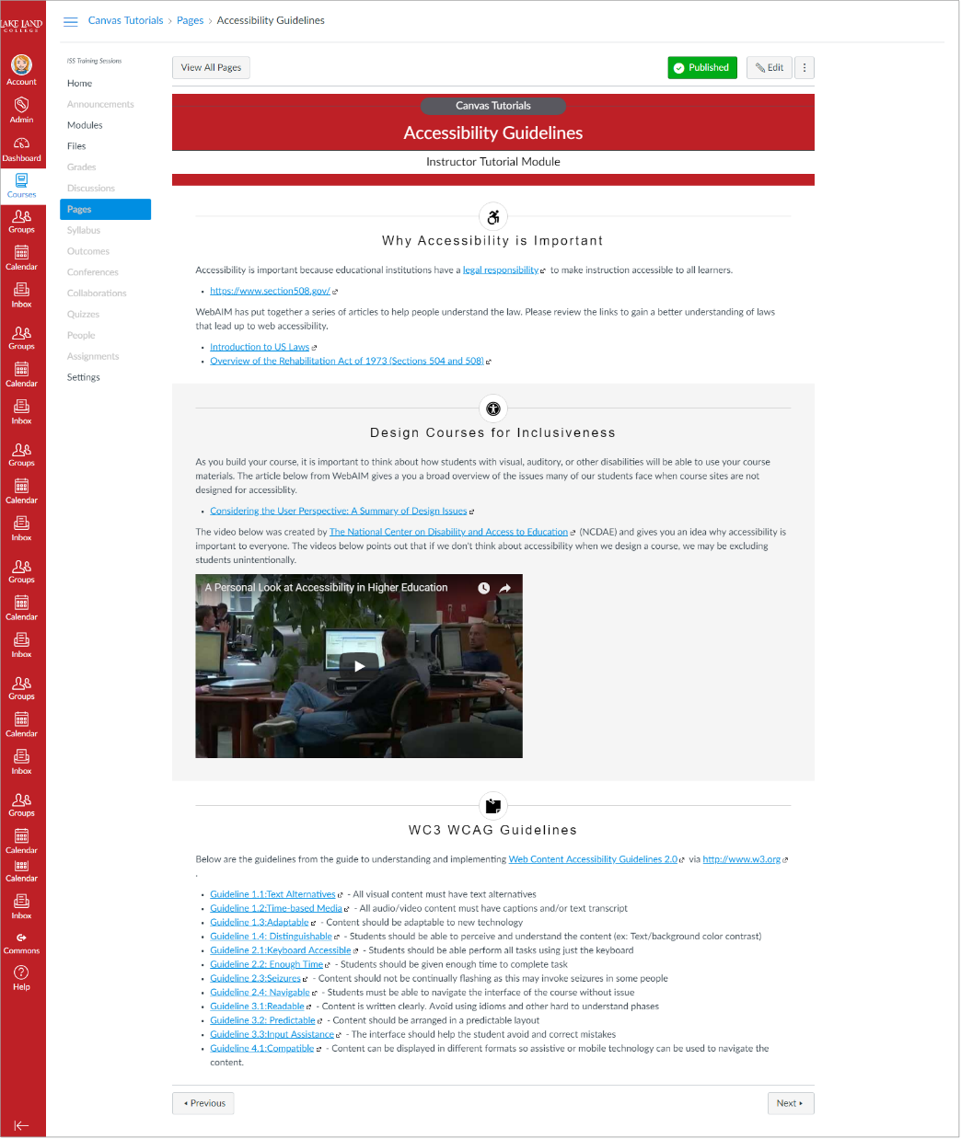
Canvas Tutorial Site
https://lakeland.instructure.com/courses/1455362
We have an open course site with Canvas Community resources and accessibility resources.
This site is linked in an admin announcement on Canvas dashboard.
Includes an accessibility page that includes a video and link to WCAG 2.0 guidelines.
https://lakeland.instructure.com/courses/1455362/pages/accessibility-guidelines

Slide 9
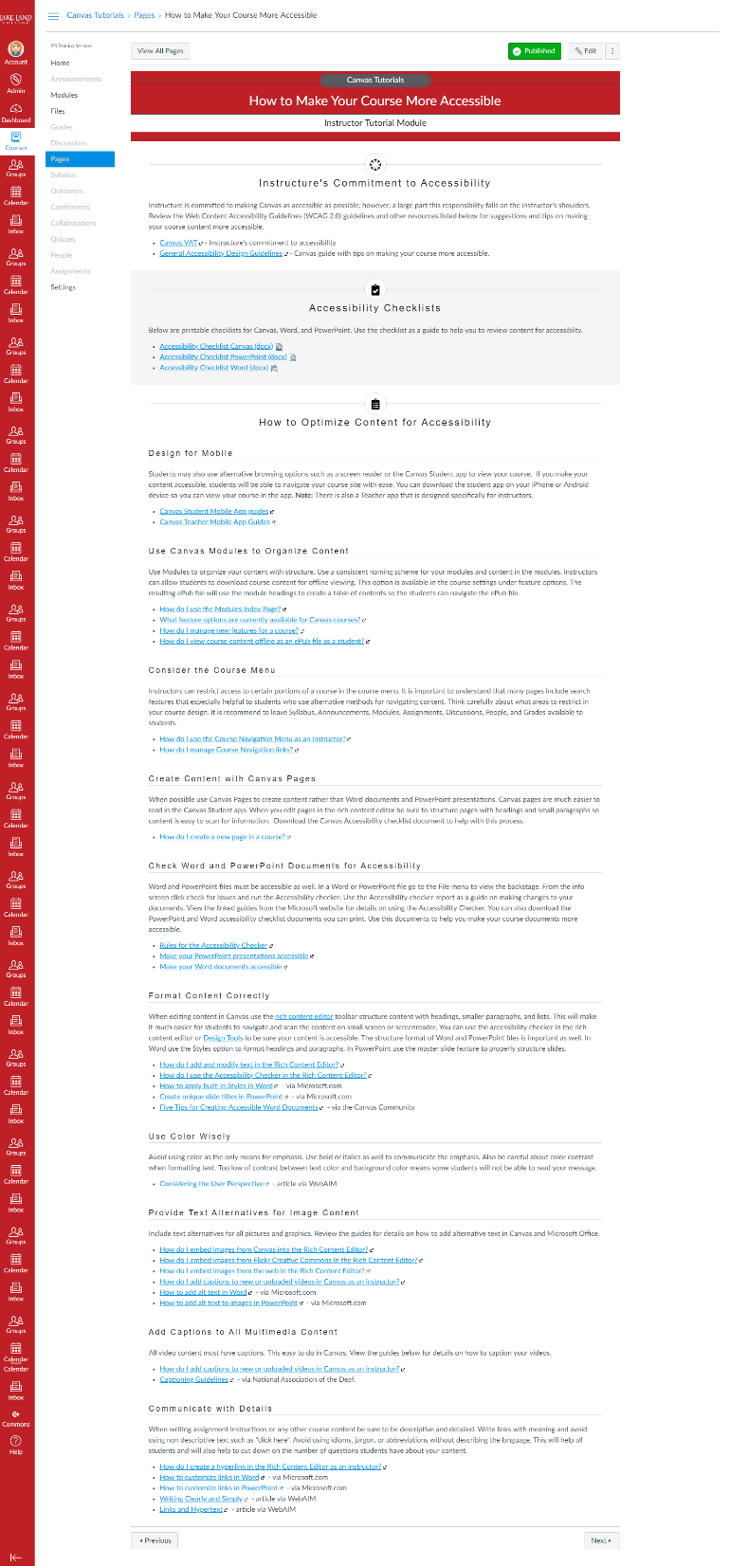
Canvas Tutorial Site (Continued)
This page includes tips and links to Canvas Community resources. Topics covered include:
Instructure’s Commitment to Accessibility
Downloadable Accessibility Checklists (Canvas & MS Office)
How to Optimize content for accessibility
  Cover the WCAG 2.0 guidelines in simpler language
  Explains why the guidelines are important and how to complete the task in Canvas.
  Links directly to relevant guides
https://lakeland.instructure.com/courses/1455362/pages/how-to-make-your-course-more-accessible

Slide 10
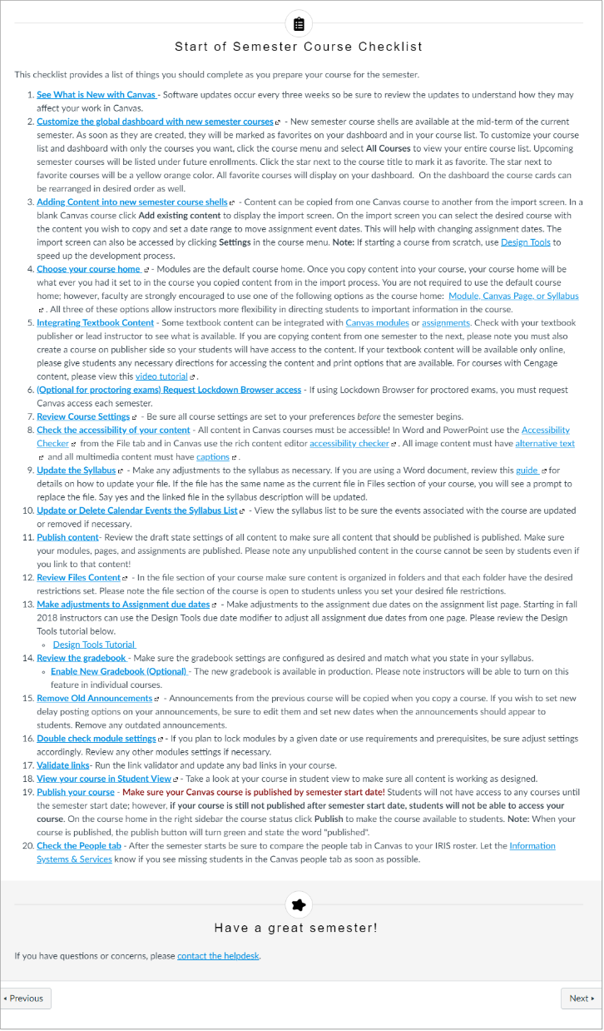
Canvas Course Site (Continued)
Semester Checklist
The Accessibility links are included in the Semester Checklist page
This page has grew over time to include all the steps instructors should complete for a successful start to the new semester.
This page is linked in admin announcement at the beginning of each semester.
https://lakeland.instructure.com/courses/1455362/pages/semester-checklist

Slide 11
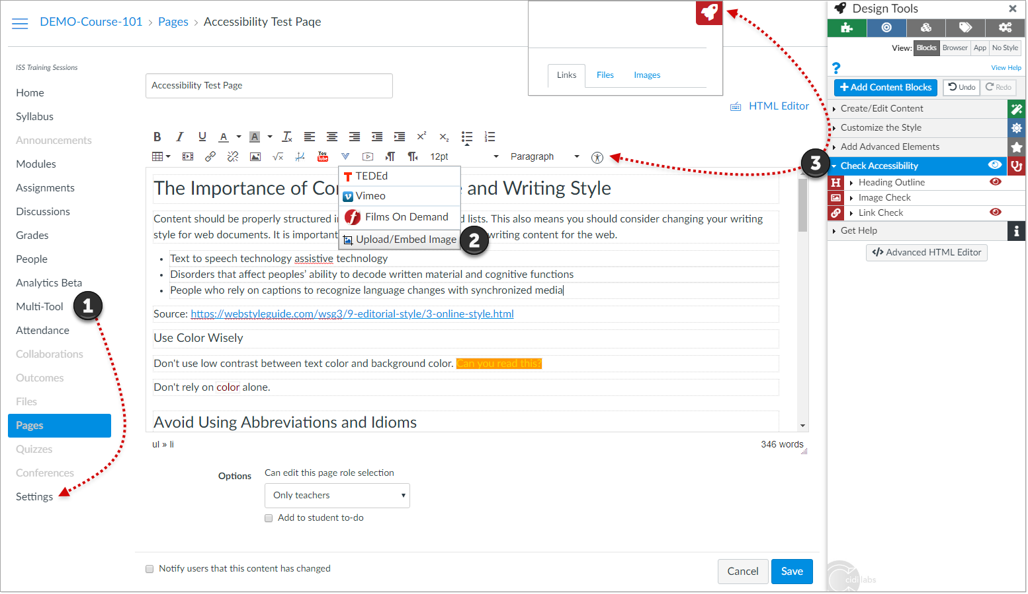
Design Tools
https://www.cidilabs.com/
We purchased Design Tools in 2018. It integrates with Canvas and has some accessibility tools. Design Tools is designed to make courses development easier for faculty. The resulting course sites are easier for students to navigate as well.

Slide 12
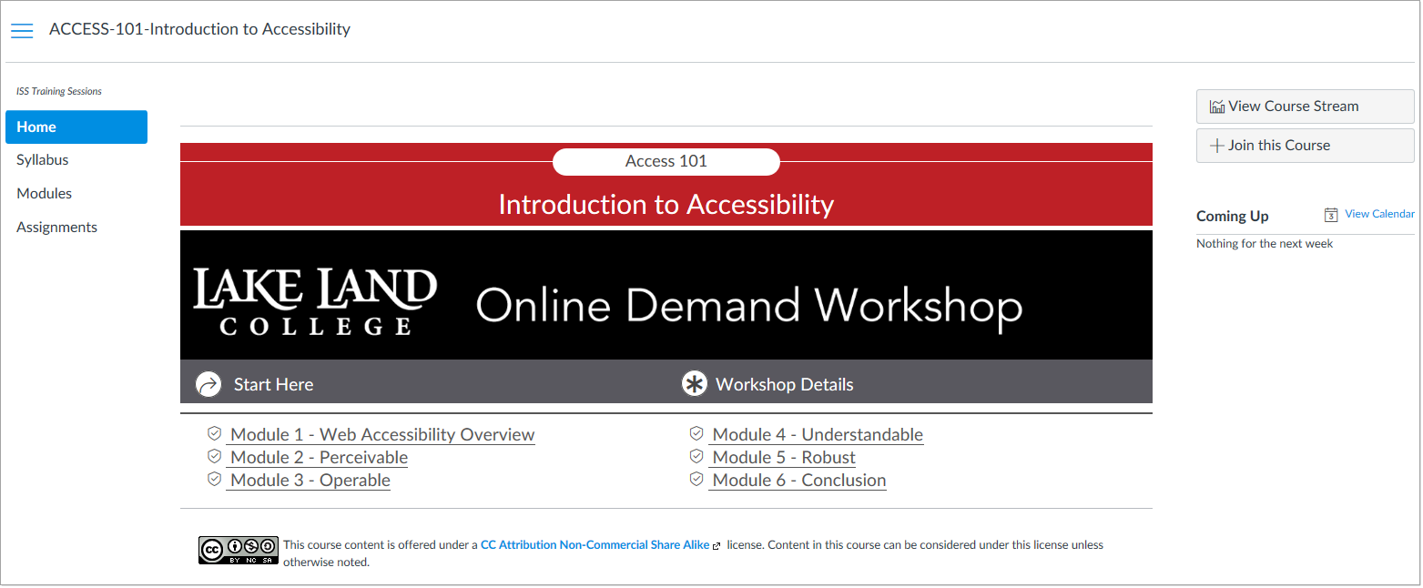
Online Demand Workshops
In our admin settings we have the join course option for manually created courses turned on and this allows faculty to join the training site when they want.
This course was designed with Design Tools

Slide 13
Currently Reviewing Video Platforms
Instructure Arc
TechSmith Rely
Easy video creation
Provides storage & permissions
Auto captions available
Using Canvas permissions you can give other people access video to caption
Can edit and create metadata for videos
https://www.arcmedia.com/
Easy video creation
Provides storage & permissions
Auto captions available
Can assign people to caption videos
Can make small edits to video
https://www.techsmith.com/lecture-capture.html
We haven’t make a decision yet but hope to have software in place for fall 2019.

Slide 14
Conclusion
Get buy in from administrative staff and faculty
Provide support for faculty (training and technical)
Encourage faculty to be more proactive rather than retroactively when addressing accessibility issues.
Have accessibility champions on campus (staff and faculty)
Review all software solutions that can speed up the process of getting content to be more accessible
Show that accessible content can improve student outcomes

Slide 15

Richland Community College’s
Road to Accessibility
Added accessibility statement to website footer
Got buy-in from Administrators
Put together an Accessibility Taskforce that developed our Accessibility Plan of attack
Purchased additional software to help make this process easier for instructors
Grant for 6 staff/faculty to attend Accessibility training offered through ION
Working to get buy-in from faculty

Slide 16
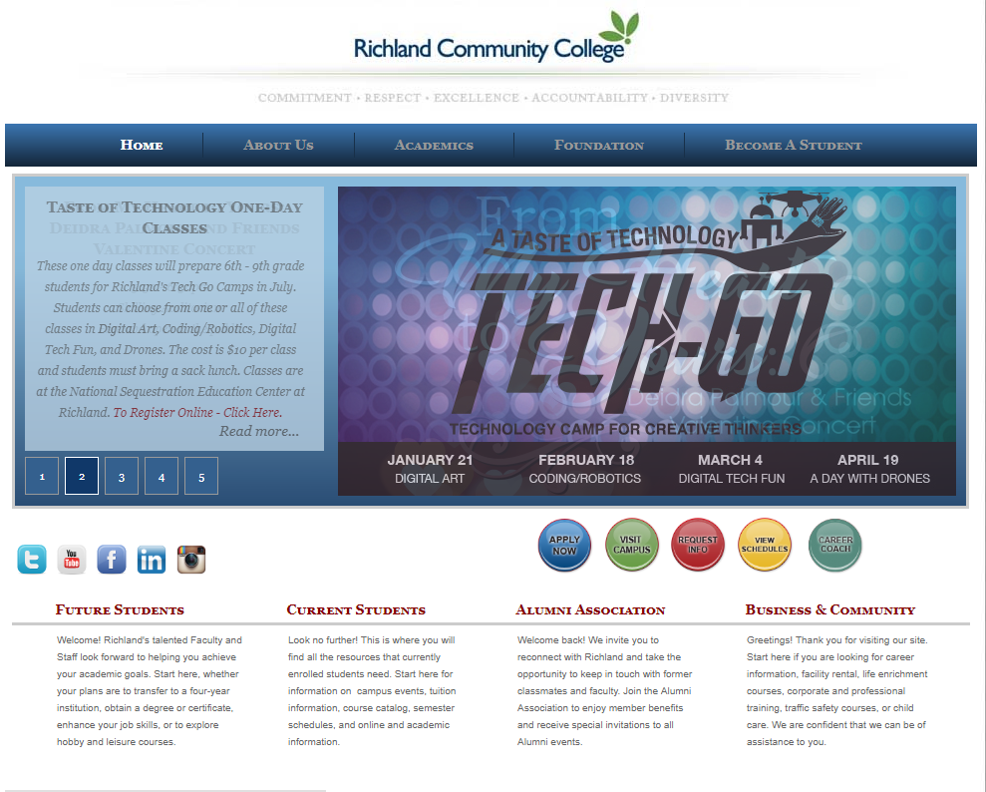
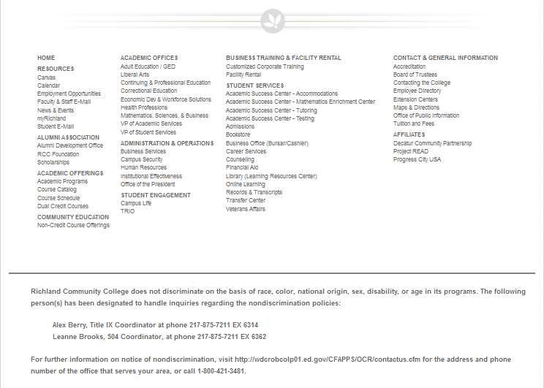
Added an Accessibility Statement to Website
Non discrimination statement
Provided the contact people at Richland for Title IX and 504.
Who to contact for additional information.

Slide 17
Added an Accessibility Statement to Website
Richland Community College does not discriminate on the basis of race, color, national origin, sex, disability, or age in its programs. The following person(s) has been designated to handle inquiries regarding the nondiscrimination policies:
Alex Berry, Title IX Coordinator at phone 217-875-7211 EX 6314
Leanne Brooks, 504 Coordinator, at phone 217-875-7211 EX 6362
For further information on notice of nondiscrimination, visit http://wdcrobcolp01.ed.gov/CFAPPS/OCR/contactus.cfm for the address and phone number of the office that serves your area, or call 1-800-421-3481.

Slide 18
Accessibility Plan
Taskforce
  CIO
  Director, Online Learning
  Director, LRC
  Accommodations specialist
  Faculty
Plan
  Video
  Website
  LMS
  Documents

Slide 19

Arc Media – Audio & Video solution
Features
  Easily create and upload video
  Can edit video
  Can embed quiz questions
  Students can comment on video
  Analytics
  High quality auto captioning
  Students can use to create video
  Integrates directly with Canvas
Timeline
Summer 2018
  Transition to Arc and push for captions started.
Fall 2018
  Continue transition
Spring 2019
  All video in LMS should be captioned

Slide 20
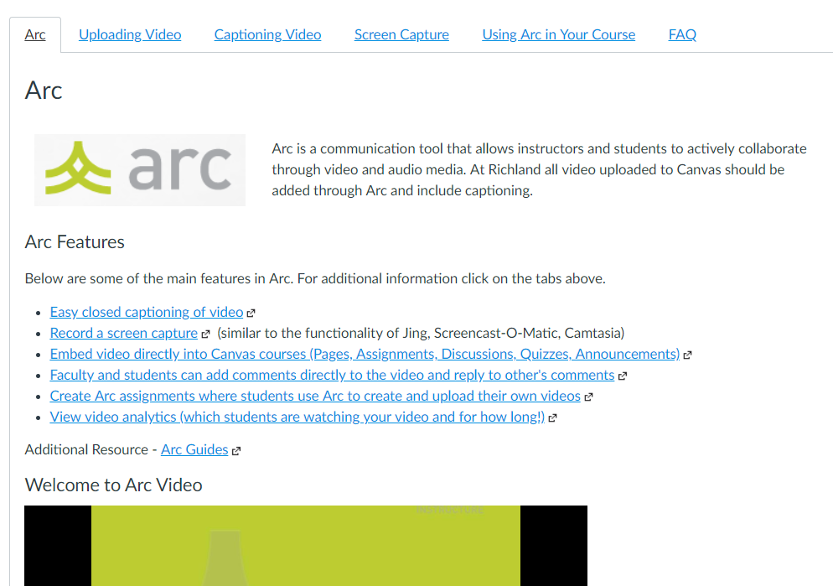
Arc Faculty Training

Slide 21
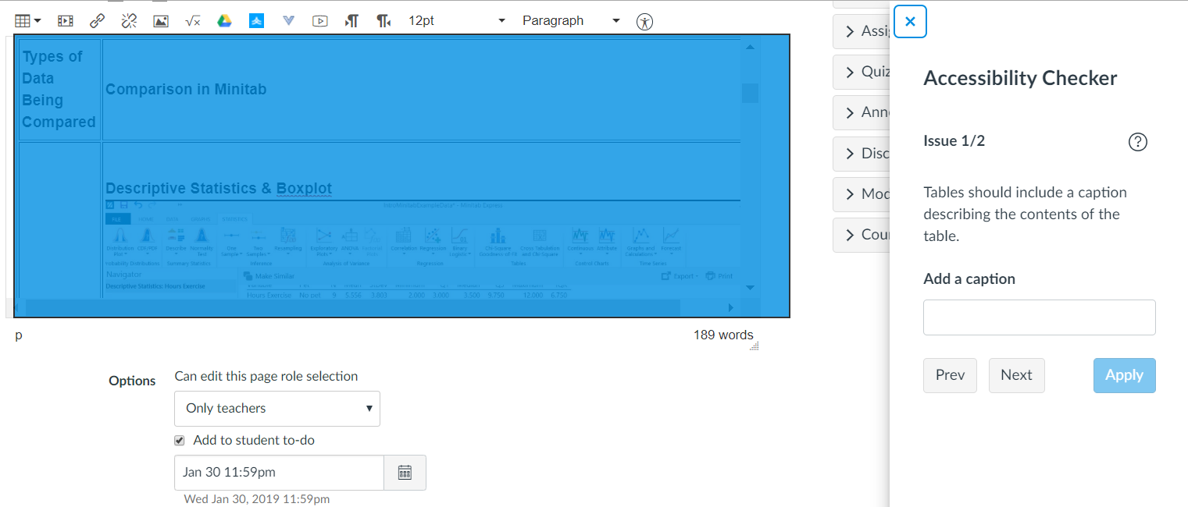
Canvas Accessibility Checker

Slide 22
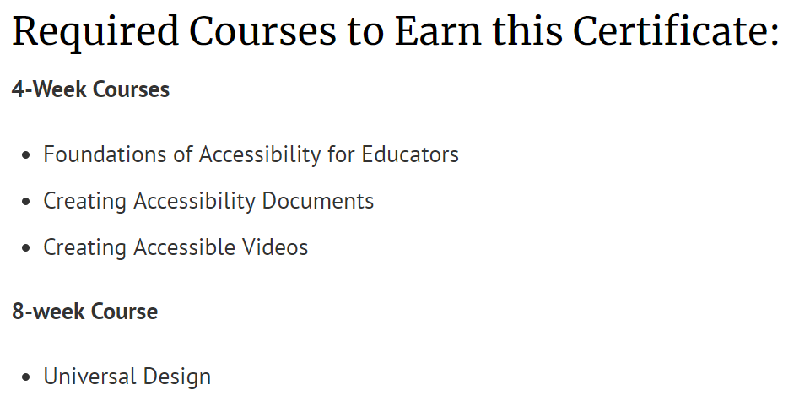
Digital Accessibility for Educators Certificate (ION)

Slide 23
Looking forward…
Develop additional accessibility training materials
Develop additional accessibility training workshops
Continue working to get buy-in from faculty

Slide 24
College of Lake County’s
Road to Accessibility
Support from the Administration
The theme of Equity
Accessibility Taskforce
Adopting Tools with Accessibility as a Primary Attribute
Faculty Investment and Training

Slide 25

The Theme of Equity
Development Week Presentation from Dr. J. Luke Wood Co-Director, Community College Equity Assessment Lab (CCEAL) San Diego State University
Developing next Strategic Plan
Connect work in Equity to efforts in Accessibility
Equity refers to a heightened focus on groups experiencing disproportionate impact in order to remediate disparities in their experiences and outcomes.

Slide 26
Accessibility Taskforce
Taskforce Members
  VP of Student Development
  Director, Public Relations
  CIO
  Director, Disability Services
  Director, Human Resources
  Director, Educational Technology
  Web Developer
  Director, Facilities
  Academic Dean
  Faculty

Slide 27
New Tools with Accessibility Focus: Panopto
Video Production and Captioning for Faculty & Students
  Caption video content when it is created
  Auto-generated Machine Captioning
  Video Captions are configurable for the Viewer
  Coordinated with DSO throughout the trial process
  Exploring using Student Workers in captioning process
http://www.panopto.com

Slide 28
Faculty Investment and Training
Combine Accessibility Efforts with Adoption of New LMS
Public Relations Accessible Document Training Initiative for All College Employees – Fall 2019
Accessibility Training integrated into Online Teaching Preparation requirements
Captioning Training in Panopto
Messaging to be Proactive with Accessibility

Slide 29
Next Steps…
Creation of Accessibility Plan
Model Universal Design Principles
Implementation
Offer Internal and External Training opportunities to Faculty

Slide 30
Conference Schedule
February 19 12:00 PM | KEYNOTE: Accessibility: A Civil Right | Vance Martin , University of Illinois Springfield
February 19 2:00 PM | Mapping Your Success: Universal Design for Learning | Zach Petrea, Heartland Community College
February 20 10:00 AM | Simple Solutions: Accessibility for Audio and Video Resources | Robin Fisch, Sauk Valley Community College Lori Wendt, Parkland College
February 20 2:00 PM | Moving Down the Road to Success: How to Approach Accessibility | Kona Jones, Richland Community College Scott Rial, College of Lake County Susan Nugent, Lake Land College
February 21 10:00 AM | Moving Down the Road to Success: How Different Learning Management Systems Address Accessibility | Kona Jones, Richland Community College Selom Assignon, Harold Washington College Lara Tompkins, College of DuPage
February 21 2:00 PM | Digital Access and YOU | Becky Benkert & Mike Maxse, College of DuPage

